Slide 1
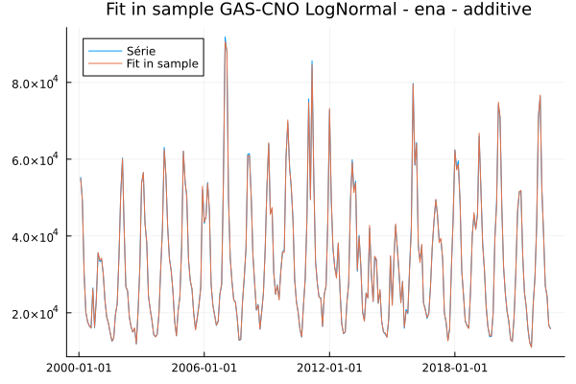
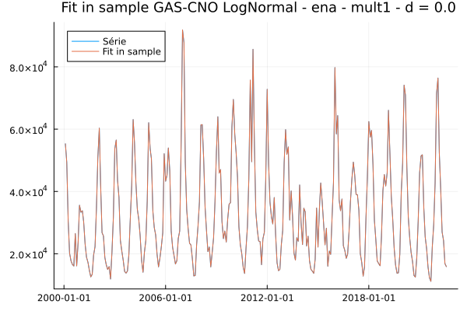


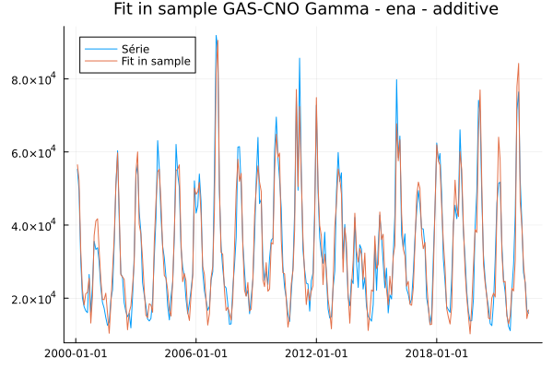
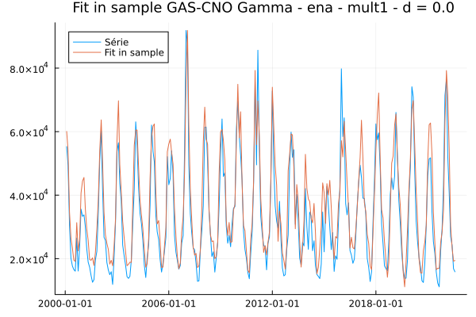
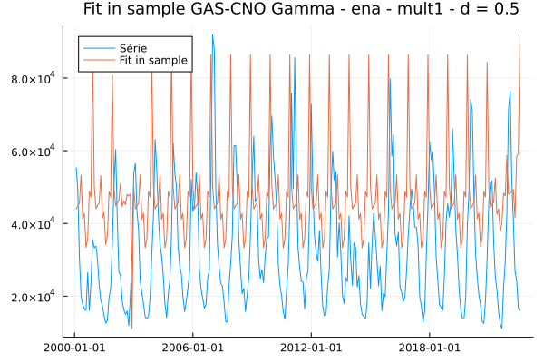
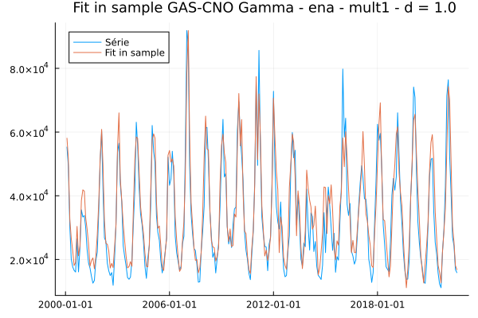
ENA Mult1 Fit in Sample
MAPES in Sample | Aditiva | Mult1 d = 0 | Mult1 d = 0.5 | Mult1 d = 1
LogNormal | 0.75 | 0.01 | 0.05 | 0.19
Gamma | 11.98 | 18.82 | 5.97 | 16.01

Slide 2
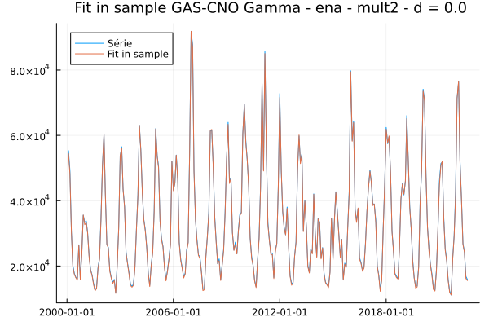
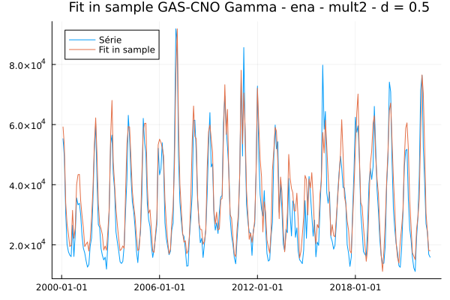
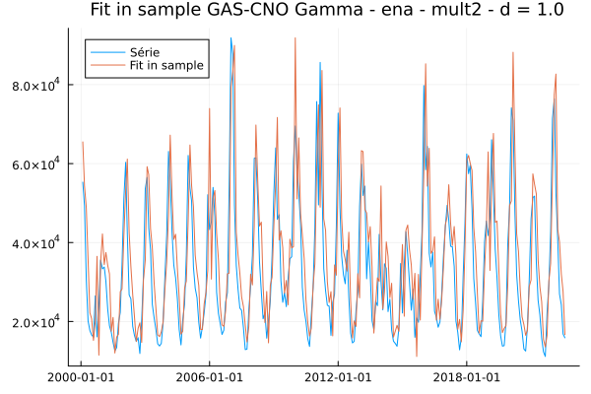

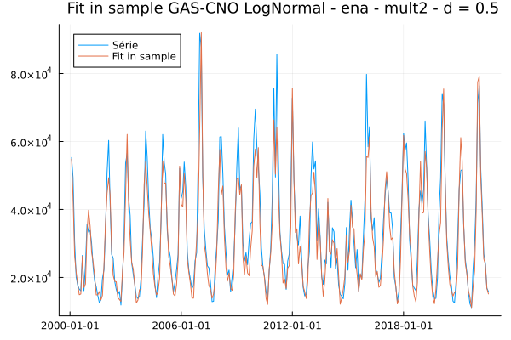

ENA Mult2 Fit in Sample
MAPES in Sample | Aditiva | Mult2 d = 0 | Mult2 d = 0.5 | Mult2 d = 1
LogNormal | 0.75 | 0.0 | 10.8 | 10.81
Gamma | 11.98 | 1.14 | 17.93 | 27.76

Slide 3
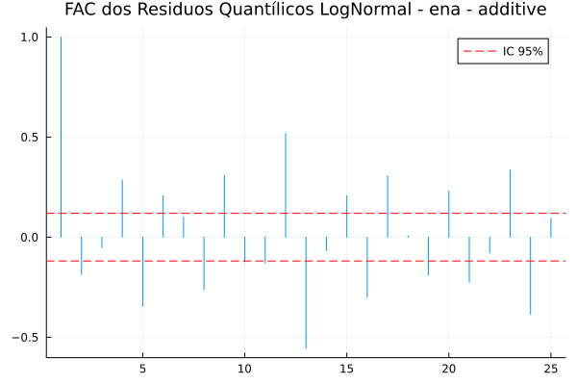
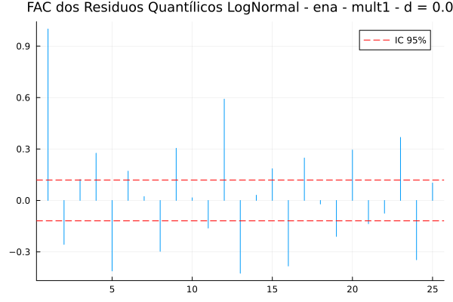
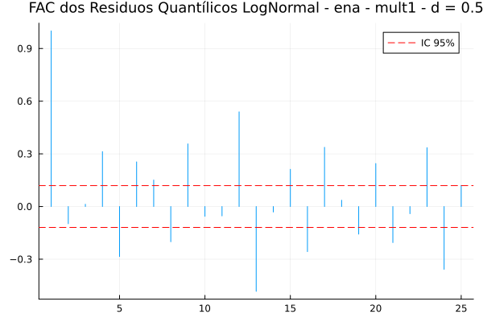
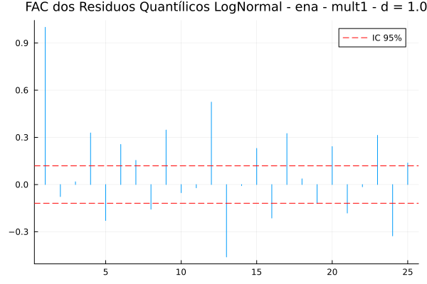
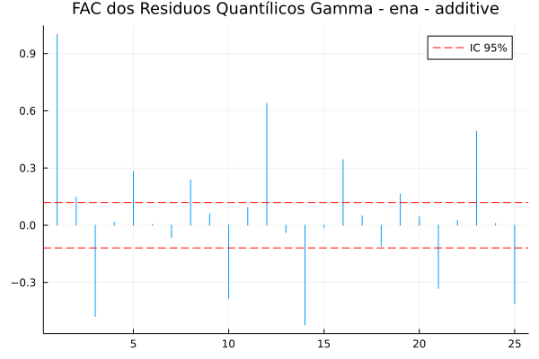
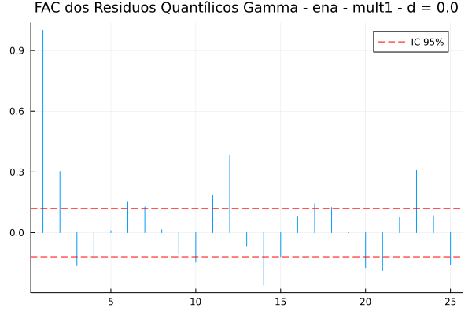
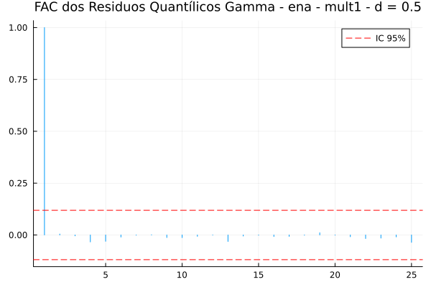
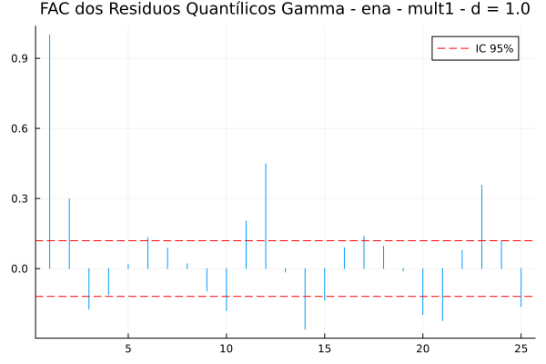
ENA Mult1 FAC Residuos

Slide 4
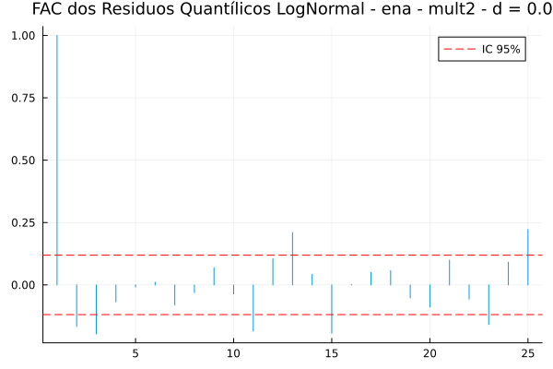
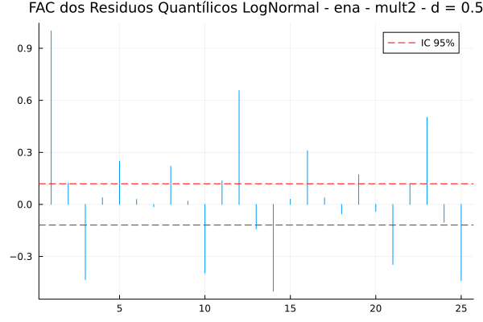
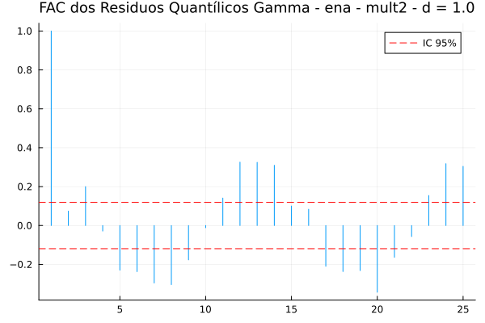
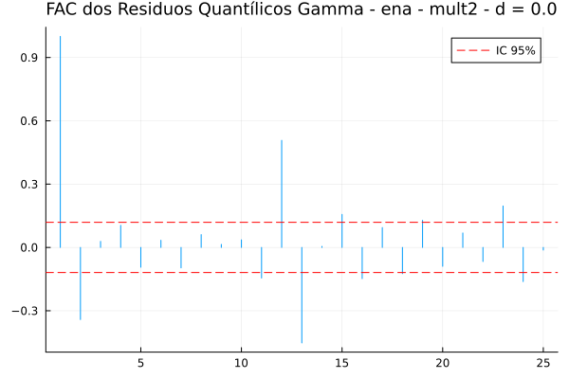
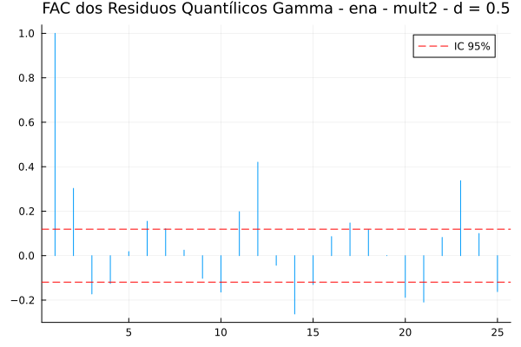
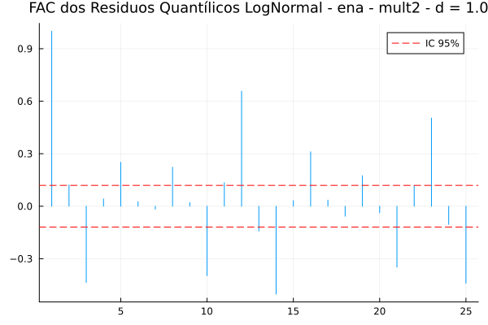
ENA Mult2 FAC Residuos

Slide 5
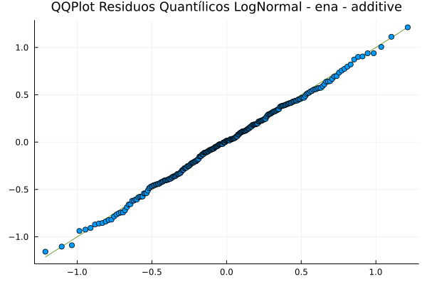
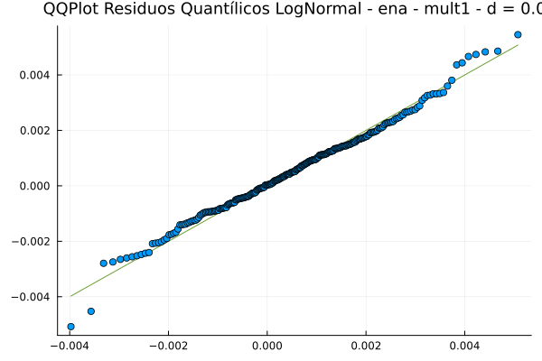
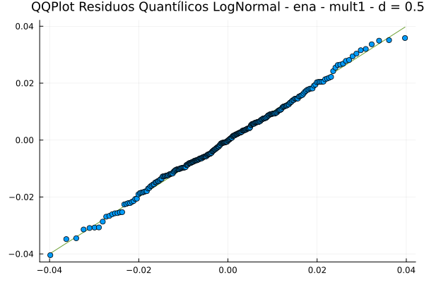
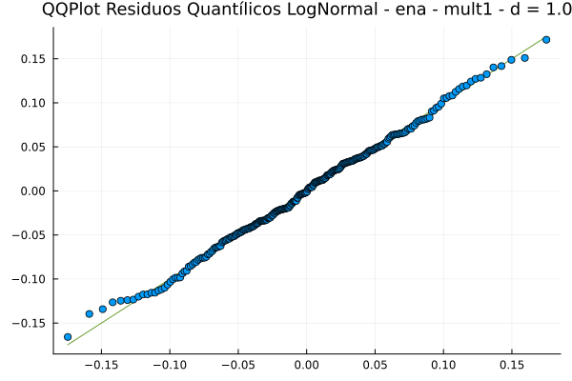
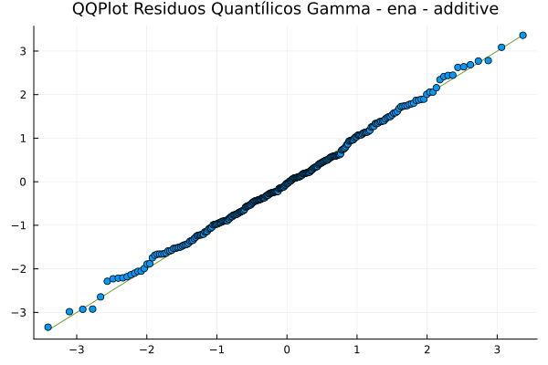
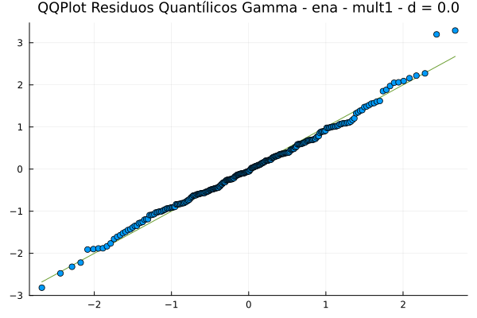
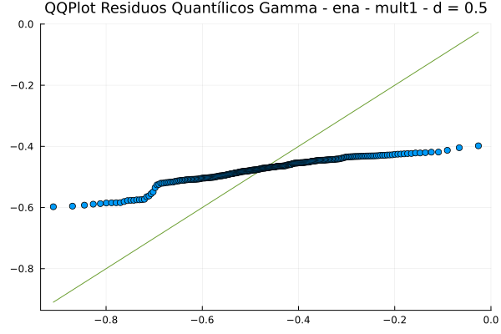
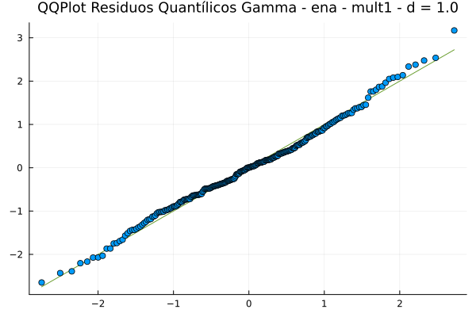
ENA Mult1 QQPlot Residuals

Slide 6
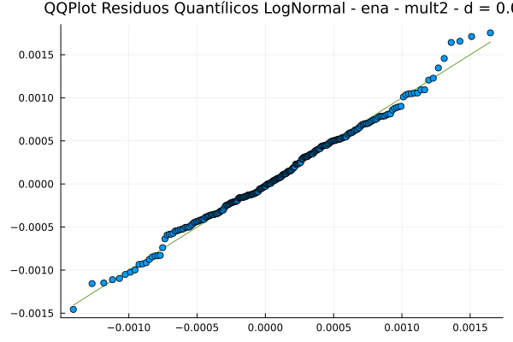
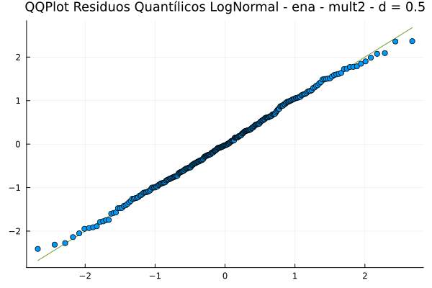
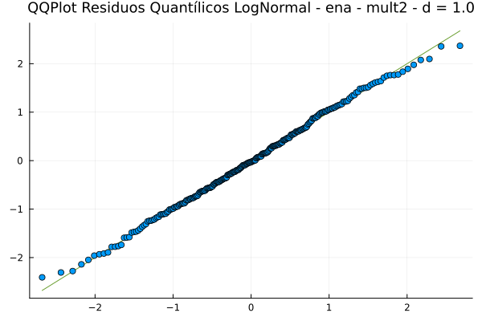
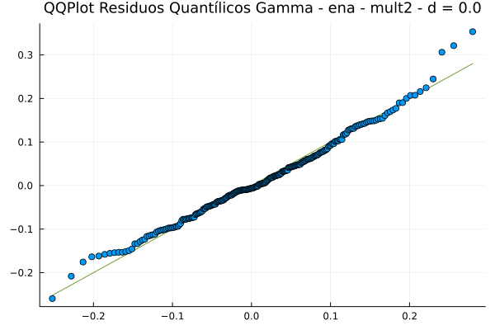
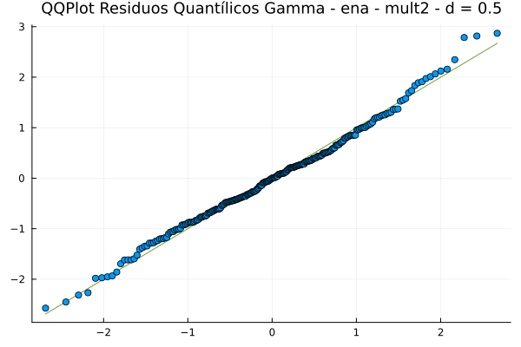
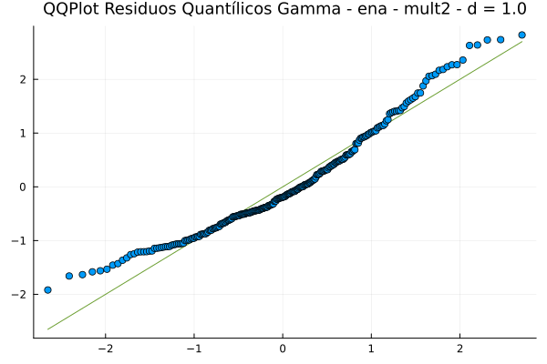
ENA Mult2 QQPlot Residuals

Slide 7
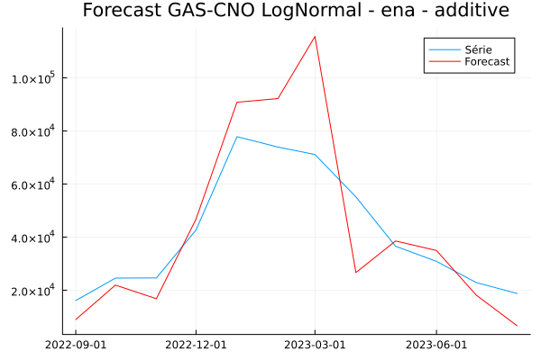
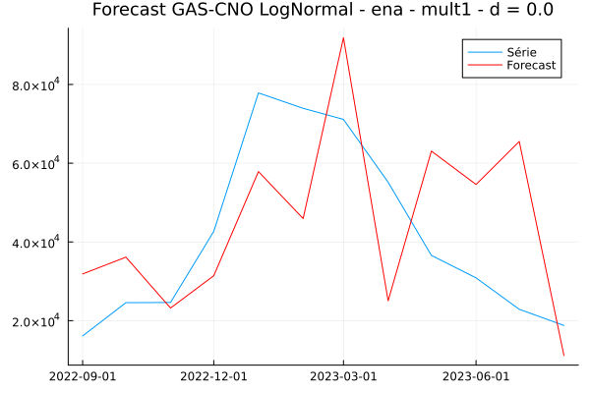

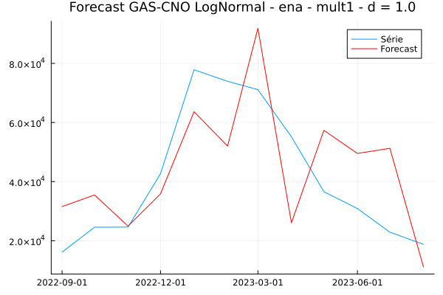
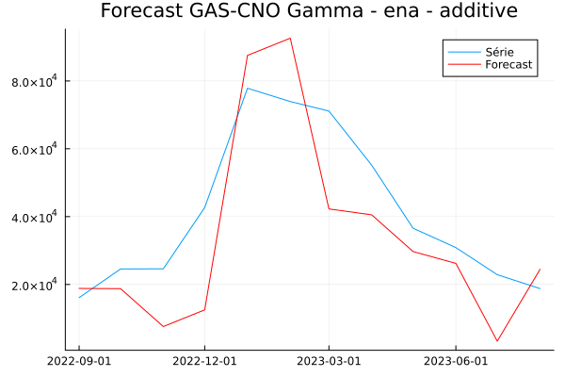
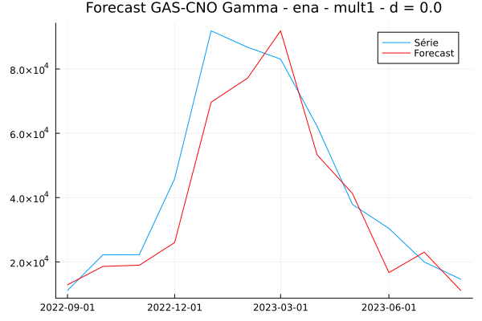
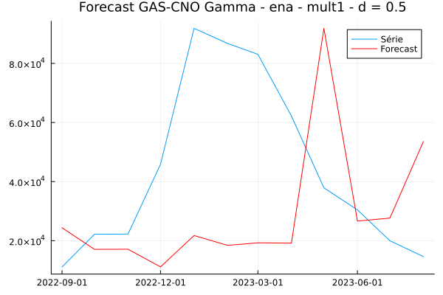
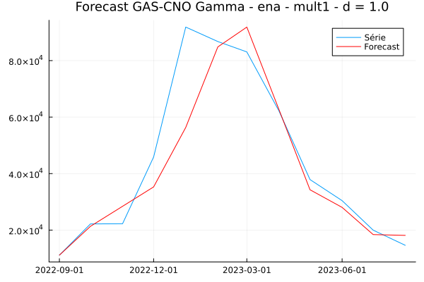
ENA Mult1 Forecast
MAPES Out of sample | Aditiva | Mult1 d = 0 | Mult1 d = 0.5 | Mult1 d = 1
LogNormal | 29.69 | 58.4 | 56.47 | 47.44
Gamma | 36.25 | 20.27 | 88.07 | 13.02

Slide 8
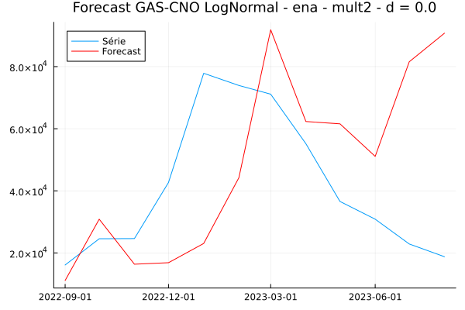
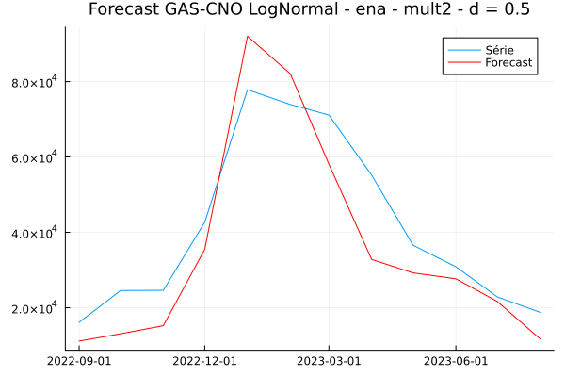
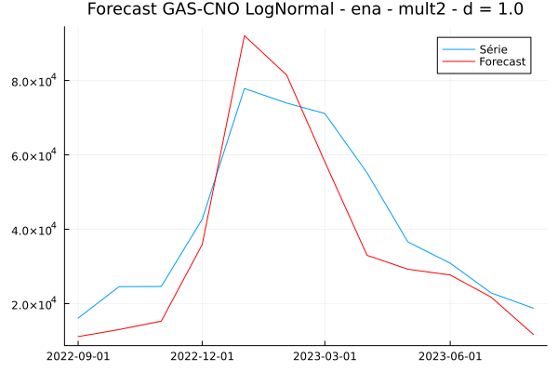
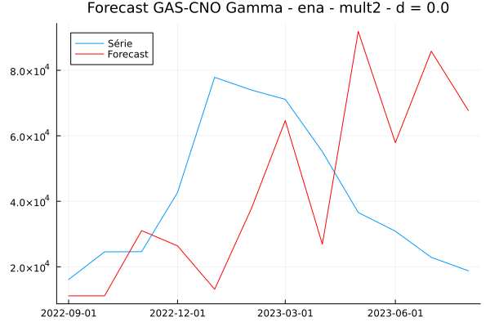
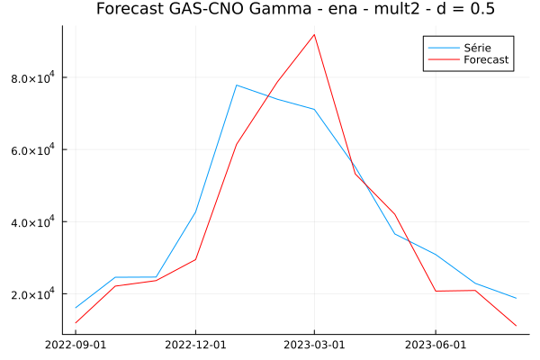

ENA Mult2 Forecast
MAPES Out of sample | Aditiva | Mult2 d = 0 | Mult2 d = 0.5 | Mult2 d = 1
LogNormal | 29.69 | 89.77 | 24.49 | 24.27
Gamma | 36.25 | 93.04 | 19.05 | 137.19

Slide 9








Airline Mult1 Fit in Sample
MAPES in Sample | Aditiva | Mult1 d = 0 | Mult1 d = 0.5 | Mult1 d = 1
LogNormal | 0.51 | 0.06 | 0.3 | 2.59
Gamma | 0.8 | 0.22 | 0.64 | 0.01

Slide 10






Airline Mult2 Fit in Sample
MAPES in Sample | Aditiva | Mult2 d = 0 | Mult2 d = 0.5 | Mult2 d = 1
LogNormal | 0.51 | 0.01 | 0.19 | 0.01
Gamma | 0.8 | 0.44 | 2.73 | 4.33

Slide 11








Airline Mult1 FAC Residuos

Slide 12






Airline Mult2 FAC Residuos

Slide 13








Airline Mult1 QQPlot Residuals

Slide 14






Airline Mult2 QQPlot Residuals

Slide 15








Airline Mult1 Forecast
MAPES Out of sample | Aditiva | Mult1 d = 0 | Mult1 d = 0.5 | Mult1 d = 1
LogNormal | 3.75 | 33.29 | 29.01 | 59.66
Gamma | 6.8 | 65.52 | 59.12 | 35.96

Slide 16






Airline Mult2 Forecast
MAPES Out of sample | Aditiva | Mult2 d = 0 | Mult2 d = 0.5 | Mult2 d = 1
LogNormal | 3.75 | 38.82 | 30.35 | 29.68
Gamma | 6.8 | 53.87 | 57.44 | 73.79

Slide 17








Carga Mult1 Fit in Sample
MAPES in Sample | Aditiva | Mult1 d = 0 | Mult1 d = 0.5 | Mult1 d = 1
LogNormal | 1.41 | 0.03 | 0.30 | 0.01
Gamma | 0.47 | 6.83 | 12.66 | 0.07

Slide 18




Carga Mult2 Fit in Sample
MAPES in Sample | Aditiva | Mult2 d = 0 | Mult2 d = 0.5 | Mult2 d = 1
LogNormal | 1.41 | 0.00 | 0.01 | 0.05
Gamma | 0.47 | 0.75 | - | -

Slide 19








Carga Mult1 FAC Residuos

Slide 20




Carga Mult2 FAC Residuos

Slide 21








Carga Mult1 QQPlot Residuals

Slide 22




Carga Mult2 QQPlot Residuals

Slide 23








Carga Mult1 Forecast
MAPES Out of sample | Aditiva | Mult1 d = 0 | Mult1 d = 0.5 | Mult1 d = 1
LogNormal | 5.9 | 13.33 | 27.09 | 10.04
Gamma | 4.0 | 38.91 | 25.92 | 19.56

Slide 24




Carga Mult2 Forecast
MAPES Out of sample | Aditiva | Mult2 d = 0 | Mult2 d = 0.5 | Mult2 d = 1
LogNormal | 5.9 | 21.23 | 14.81 | 14.14
Gamma | 4.0 | 36.54 | - | -

